Slide 1
FOREIGN EXCHANGE RATE PREDICTION USING ARTICLE DATA (WEB SCRAPPING & TOPIC MODELLING)
Presented By:
Anis Ghosh 1804430
Harsh Bansal 1804442
Sumit Saha 1804485
Utsab Ghosh 1804488
Tina Sasmal 1804486

Slide 2
Abstract
We have implemented machine learning techniques in order to predict the foreign exchange rates of respective countries based on the data that were fetched from various sources . We have performed web scrapping using the API key generated from the NYT articles website.Then we have used that raw data remodeled it and converted it into a usable csv formatted file on which the rest of the algorithms were performed on.We have performed various regression models on the respective countries and selected the best model on the basis of Mean Squared Error(MSE) values. We used the articular data and the macro economical data to efficiently predict the subsequent years foreign exchange rates. The novelty of our project relies on utilizing the Latent Dirichlet Allocation to cluster news articles into topics and further understand the semantic meanings behind each topic and applying it to foreign exchange rates.

Slide 3
INTRODUCTION
Our project basically surrounds upon the idea of implementing machine learning techniques and algorithms in order to predict a desired result which serves our purpose both efficiently and accurately.In the case of our project we had the purpose or goal to predict the foreign currency exchange rates for subsequent years based on the previous years data.We basically focused on the macro economical data,the foreign exchange rates and the article data in order to predict the desired result.Starting from fetching the data till deployment our project had various steps and separate teams were made with capable members and knowledge to preform the task.Contributions were welcomed from all of the team members outside of that specific groups and necessary credits were given.Our project workflow had the following steps/divisions:
1.Data Collection
2.Topic Modelling
3.Data analysis
4.Modelling
5.Deployment (Future Prospect)

Slide 4
DATA COLLECTION
Our data collection was primarily focused upon utilizing the datasets : Foreign exchange rates,Macro economical indicator Data and Article Data.For the foreign exchange rates the yearly average foreign exchange data was downloaded from year 1981 to year 2019 for the following following: Dollar-Yuan (China), Dollar-Rupee (India), Dollar-Yen (Japan), Dollar-Pound (Great Britain), Dollar-Franc (Switzerland), and Dollar-Canadian Dollar (Canada).
For the news article data we utilized the New York Times Article Search API to collect metadata from around 2000 articles per year from 1981 to 2019.We focused on the topics which were most relevant to affect the exchange rates.A python web scraper code was built in order to harvest article data and meta data for the respective years in separate csv files which were later processed and implemented along with the other datasets.
For the macro economic indicators we fetched the Gross Domestic Product(GDP),Power Purchasing Parity(PPP),Inflation rate(INFL),Export rates and the import rates from the world bank website.Later after deciding among our team members we decided to move forward with the GDP and PPP data based on the feature importance and impact that they had towards the model accuracies.
Q

Slide 5
WEB SCRAPPING METHODS
Research on web scrapping was done in order to get the required technique to scrap the new York times data. Some of the techniques found to scrap the data are Human copy-and-paste. The simplest form of web scraping is manually copying and pasting data from a web page into a text file or spreadsheet.
1.Text pattern matching.
2.HTTP programming
3.HTML parsing.
4.DOM parsing.
5.Vertical aggregation.
6.Semantic annotation recognizing
7.Computer vision web-page analysis.
8.Using API Key

Slide 6
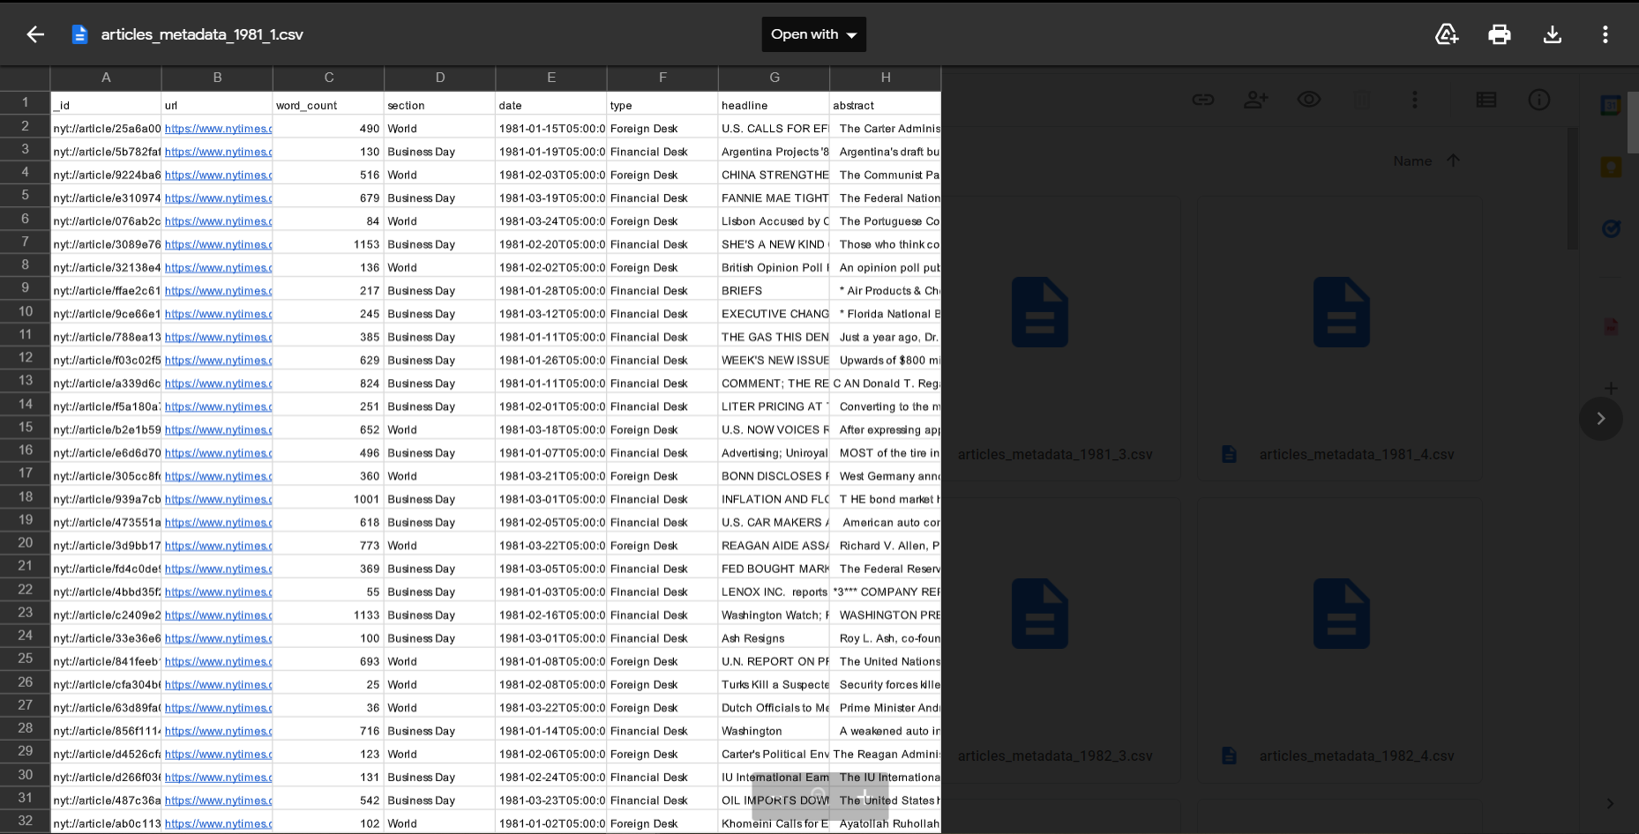
A sample screenshot of fetched meta data

Slide 7
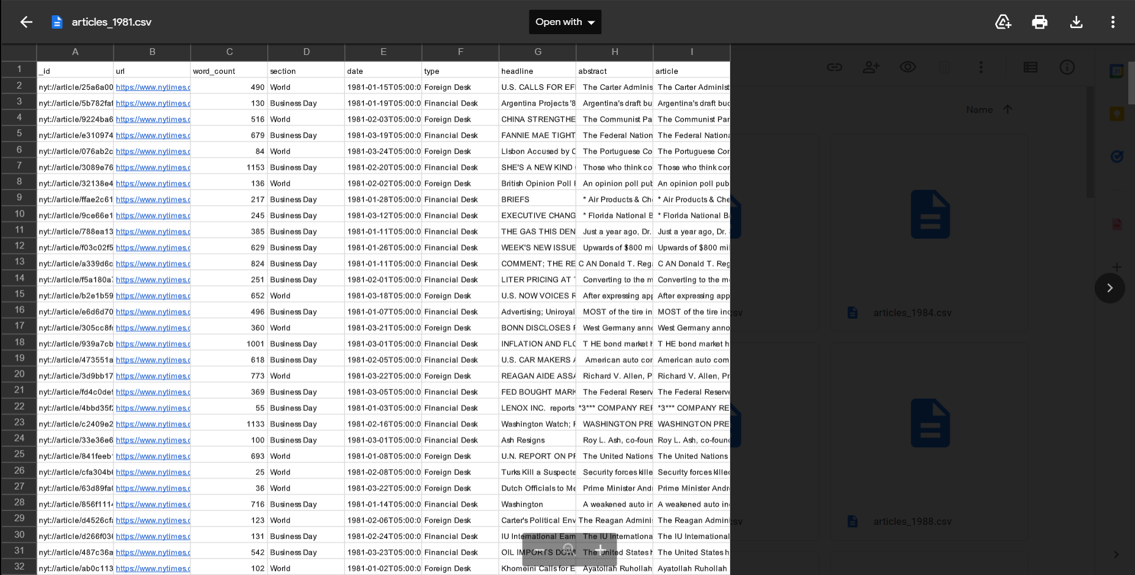
A sample screenshot of fetched article data(1981)

Slide 8
TOPIC MODELLING
To generate features from news articles, we have used one of the NLP techniques called Latent Dirichlet Allocation (LDA). Ideally each articles is categorised in some generic topics but LDA clusters the articles as per the probability for each topic based on the count-vectorization of each words in all the articles. The articles of each year are combined and transformed into single dataframe consisting of probability of every article belonging to a particular topic which is named as distribution. We tried many values for number of topics (5, 10, 15, 20, 25, 30, 40, 50).
A distribution dataframe is saved for respective number of topics. The challenge was to transform a topic modelling dataframe to merge with economic factors which consist of single row for each year while there were more than 4000 rows of articles published every year. So to resolve this issue, we calculated the mean of probabilities of a each year’s topic and converted them into single row for a particular year. This dataframe is named as weights. There is no particular method to decide an optimised number of topic for a corpus, that’s why we had to figure out a way to do so.

Slide 9
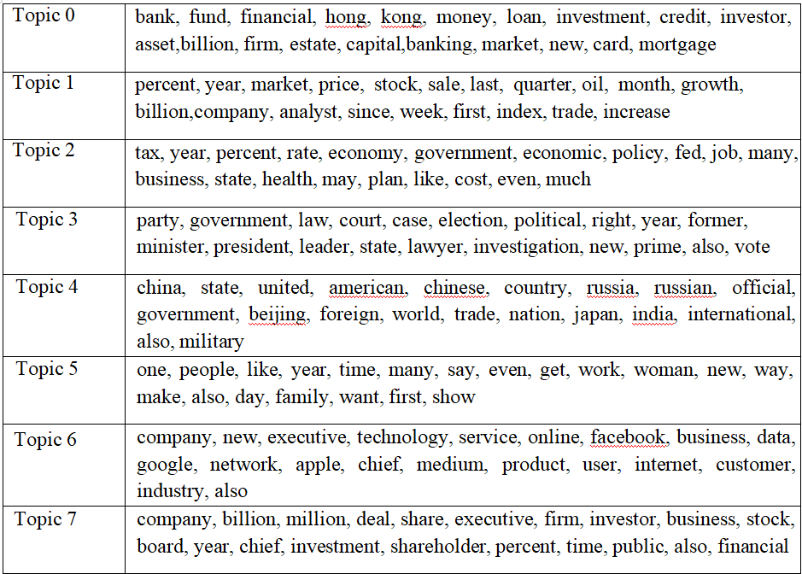
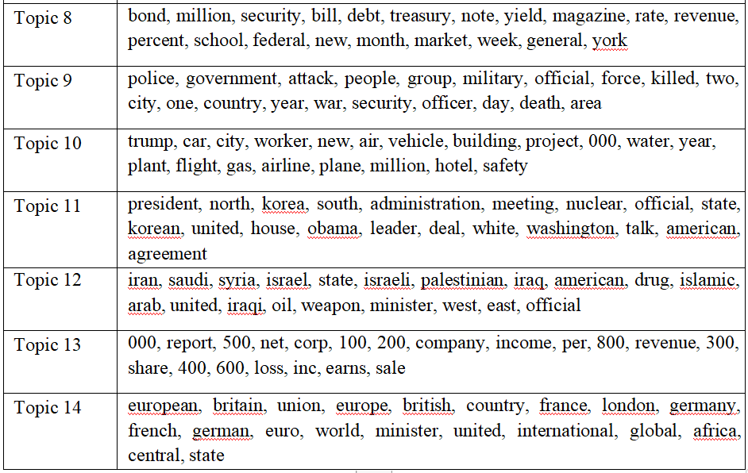
Each topic group after topic modelling

Slide 10
ANALYSIS ( EDA )
In data mining, Exploratory Data Analysis (EDA) is an approach to analyzing datasets to summarize their main characteristics, often with visual methods. EDA is used for seeing what the data can tell us before the modelling task. It is not easy to look at a column of numbers or a whole spreadsheet and determine important characteristics of the data. It may be tedious, boring, and/or overwhelming to derive insights by looking at plain numbers. Exploratory data analysis techniques have been devised as an aid in this situation.
Exploratory Data Analysis (EDA) is an approach/philosophy for data analysis that employs a variety of techniques (mostly graphical) to
Maximize insight into a data set
Uncover underlying structure
Extract important variables
Detect outliers and anomalies
Test underlying assumptions
Develop parsimonious models

Slide 11
“Before Training, any model using any algorithm Data Preprocessing is that the most significant step and will be the primary step. The data Preprocessing contains several checkpoints (steps) such as:
Step 1: Import Libraries: The essential Libraries for Data preprocessing I used are Pandas for data manipulation and analysis, Numpy for numerical analysis, Matplotlib and Seaborn for better visuals and graphical stats of the data.
Step 2: Import the Dataset: This downloaded the dataset from Kaggle, and then downloaded the dataset using the pandas library.
Step 3: Taking care of Missing Data in Dataset: After evaluation of this dataset, I found no missing values in the dataset.
Step 4: Encoding categorical data: This dataset contains some Categorical values such as ‘countries name’, so we need to encode these categorical data into an encoded format to better train our model, to do this I used get_Dummies() method of pandas and this converted the whole Categorical values in the dataset into binary values.
Step 5: Splitting the Dataset into the Training set and Test Set: To split this dataset into Test and Train dataset to train our machine learning model I used the capable machine learning library of python, scikit-learn or sklearn. Using its model selection method to create testing data by picking random values from the available dataset for model prediction, or we can say Supervised Learning.
Step 6: Feature Scaling: Since all the data, available in a standard format, so here I do not use any feature scaling techniques.

Slide 12
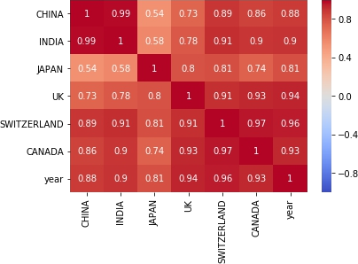
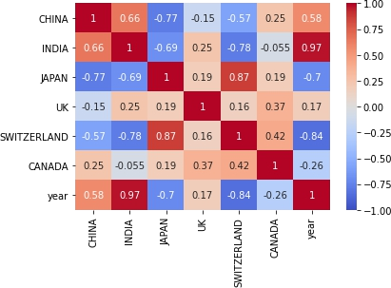
Correlation Map
GDP
FER

Slide 13
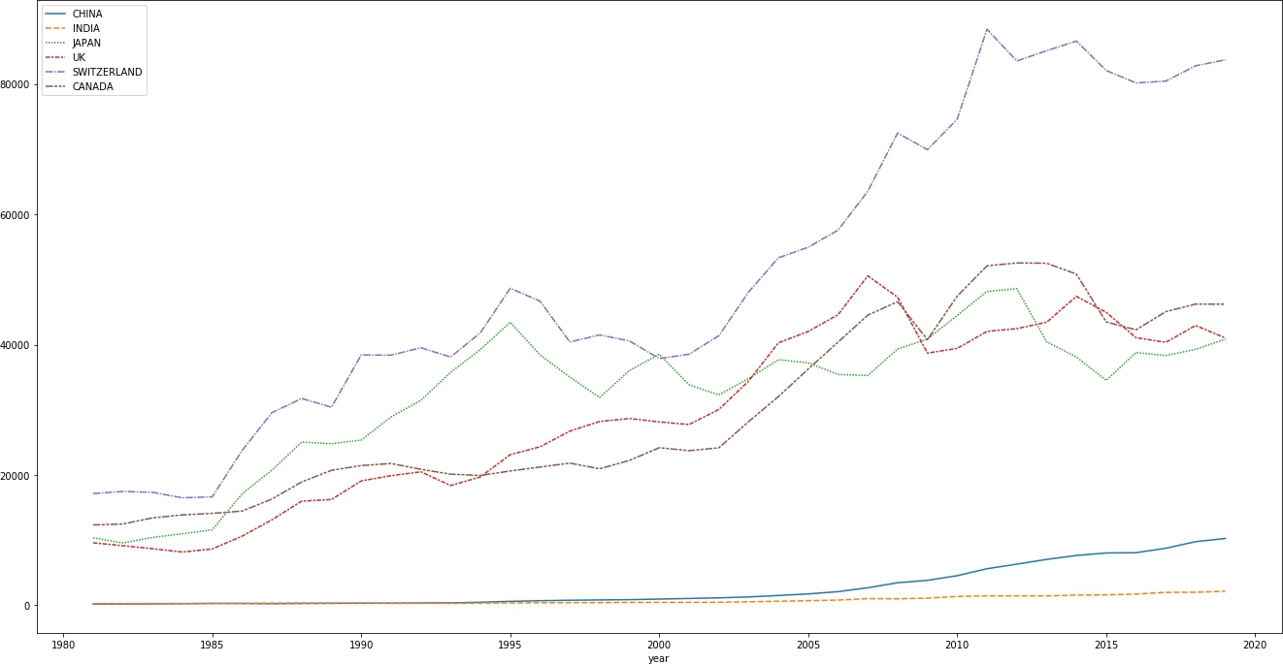
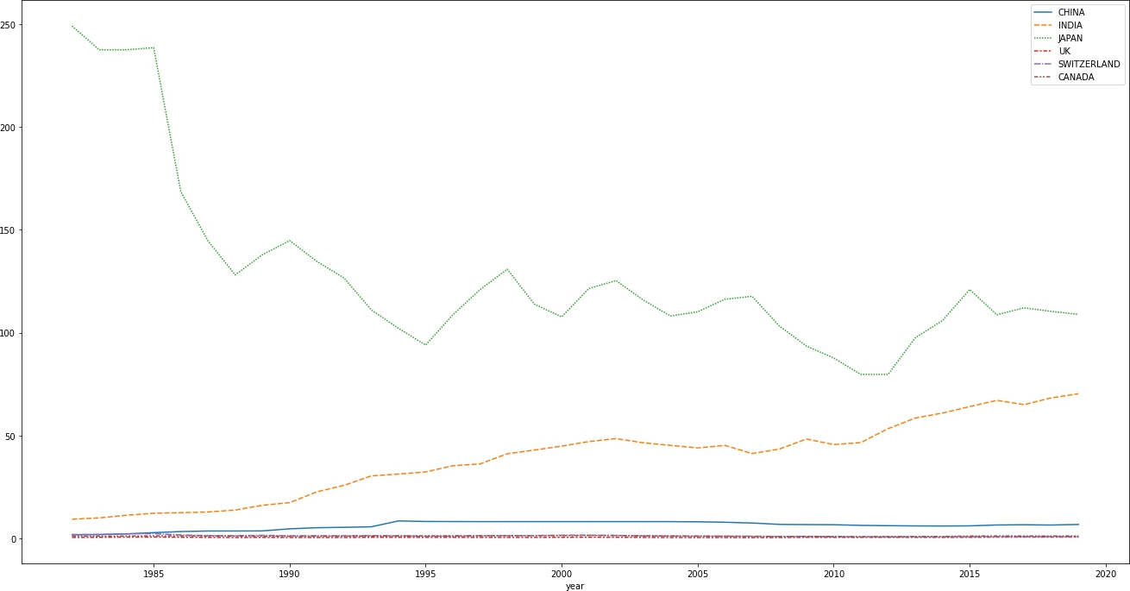
Plot showing GDP of each country
over years from 1981-2019
Plot showing FER of each country
over years from 1981-2019

Slide 14
MODELLING
We attempted to predict next year’s exchange rate using the popular models like Linear, Ridge, Lasso, Support Vector, Decision Tree and Random Forest regressors. We implemented these models using Scikit- Learn module. While selecting best accuracy model, we encountered with an issue of deflecting accuracy in every run even after fixing seed value. To solve this problem, we tried to select model using automated machine learning module called TPOT. TPOT is a tool that automatically creates and optimizes machine learning pipelines using genetic programming. We trained our data ( combination of economic factors and weights ) for every country and each topic number value and as a result we got optimal model pipelines with optimal parameters. We got best accuracy (mse) with weights having 15 topics.
The TPOTClassifier performs an intelligent search over machine learning pipelines that can contain supervised classification models, preprocessors, feature selection techniques, and any other estimator or transformer that follows the scikit-learn API. The TPOTClassifier will also search over the hyperparameters of all objects in the pipeline.
By default, TPOTClassifier will search over a broad range of supervised classification algorithms, transformers, and their parameters.

Slide 15
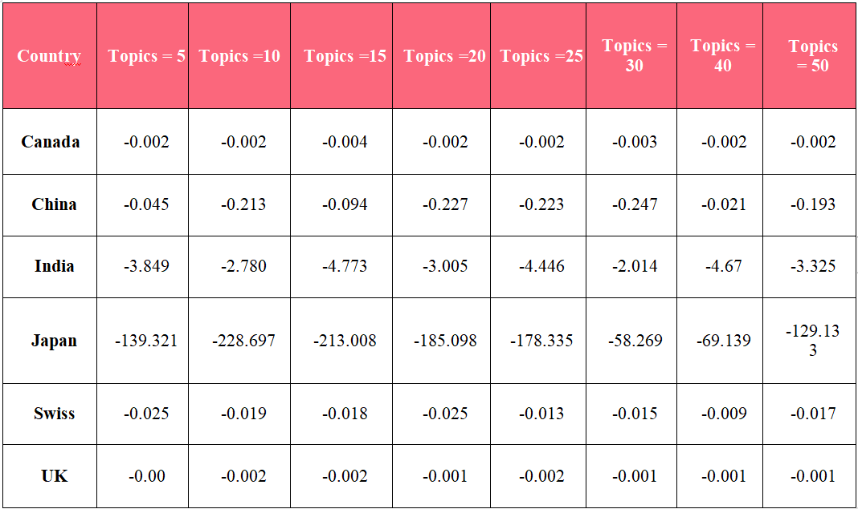
Below is the mean error rates in % (only positive) for each country and every number of topics:

Slide 16
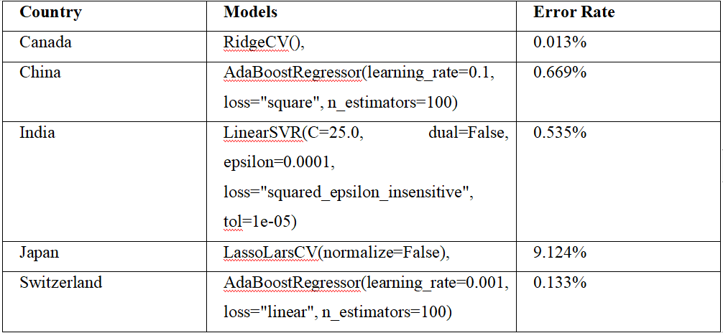
The optimised models with number of topics as 15 with parameters for prediction are:

Slide 17
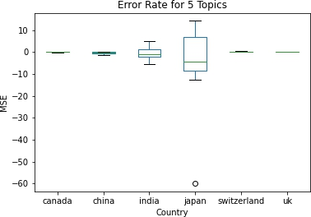
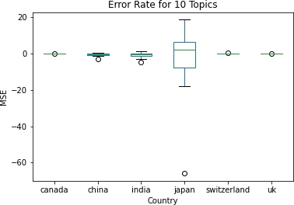
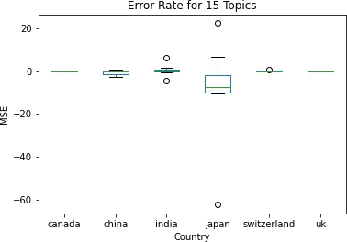
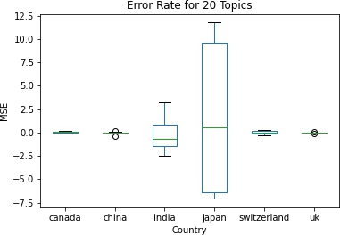
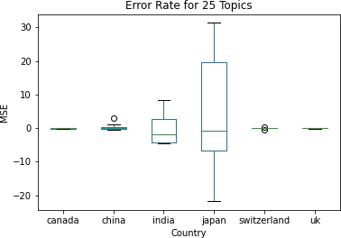
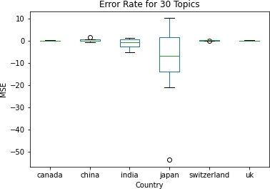
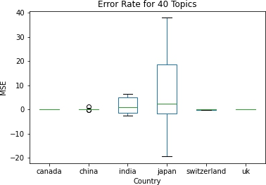
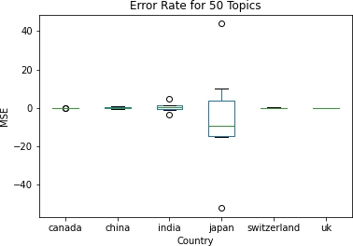
Error Plots

Slide 18
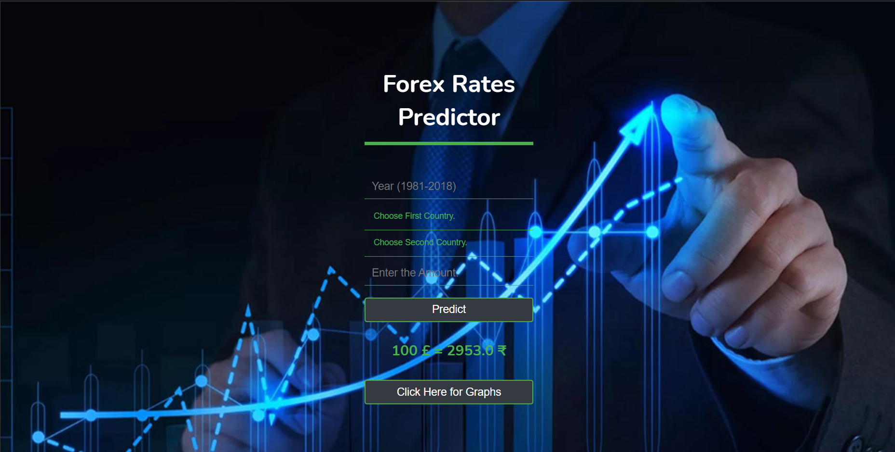
Future Prospects
To Bring our project on web we have used HTML,CSS 3 for Frontend while backend is handled by Flask.We have used Heroku to deploy our project.
We have used multiple CSS features like hover in our Predict button ,Animation in our output result .we have used background image ,google fonts ,multiple colours.
We have used box model a box that wraps around every HTML element. It consists of: margins, borders, padding, and the actual content.

Slide 19
CONCLUSION
The machine learning (web scrapping) industry is considered one of the booming and evergreen sectors across the world especially in India where it holds a prominent position in the growth of the Indian economy. The industry provides useful insights into trading, automation, and majorly into data industry. This concept of ours is a growing and evolving concept that has resulted into many revolutionary ideas and methodologies and techniques that holds the potential to change our future and puts some light into futuristic automated machine driven societies. It already holds huge importance in the data driven industry and it will continue to increase its importance. A subset of machine learning is closely related to computational statistics, which focuses on making predictions using computers; but not all machine learning is statistical learning. The study of mathematical optimization delivers methods, theory and application domains to the field of machine learning. Data mining is a related field of study, focusing on exploratory data analysis through unsupervised learning. In its application across business problems, machine learning is also referred to as predictive analytics

Slide 20
THANK YOU

